Slide 1
Briefing on the new RSHE Guidance 2026
Catherine Kirk – Achieve Well Team Manager
Catherine.kirk@nottinghamcity.gov.uk
www.achievewell.co.uk X - @AchieveWellTeam achievewell@nottinghamcity.gov.uk
LinkedIn – Achieve Well Team

Slide 2

First and foremost…..
The new guidance does not need to be implemented until September 2026!

Slide 3

Relationships Education, Relationships and Sex Education and Health Education guidance 2025 Replaces previous guidance of 2019 Implementation from September 2026 although schools can implement sooner Achieve Well - RSHE Guidance 2025

Slide 4
Introduction
“Children and young people need knowledge and skills that will enable them to make informed and ethical decisions about their wellbeing, health and relationships. High quality, evidence-based teaching of relationships, sex and health education (RSHE) can help prepare pupils for the opportunities and responsibilities of adult life, and can promote their moral, social, mental and physical development. Effective teaching will support young people to cultivate positive characteristics including resilience, self-worth, self-respect, honesty, integrity, courage, kindness, and trustworthiness. Effective teaching will support prevention of harms, by helping young people understand and identify when things are not right”

Slide 5

The guidance is framed with a set of guiding principles. Let’s look at implementation through the lens of these principles…

Slide 6

1. Engagement with pupils
“Schools have significant freedom to implement this guidance in the context of a broad and balanced curriculum. A school’s curriculum should be in line with the needs of pupils.”

Slide 7
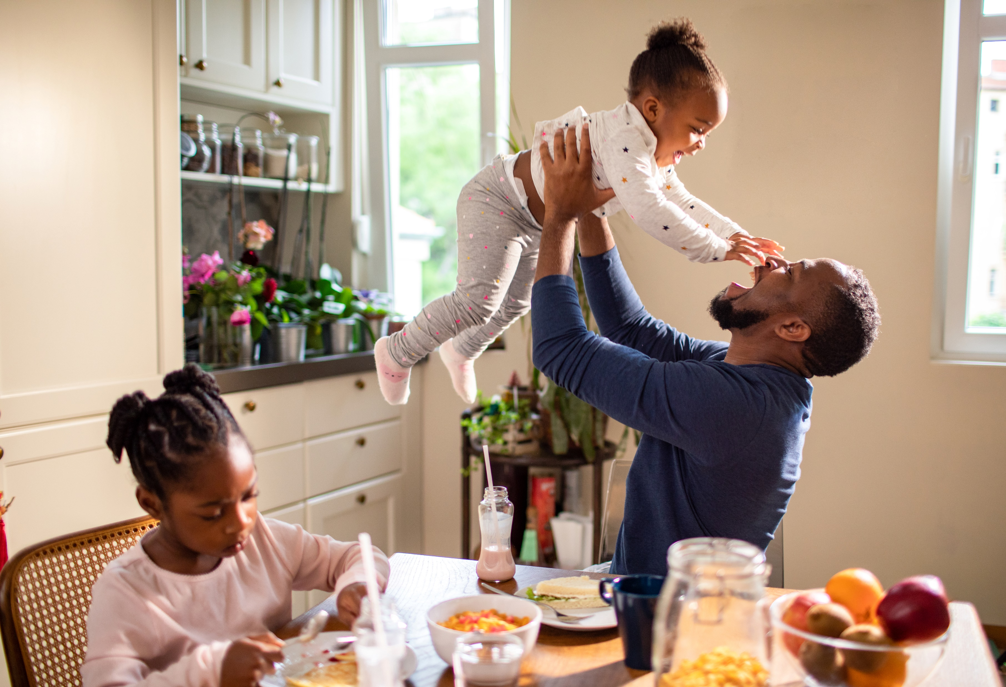
2. Engagement and transparency with parents

Slide 8
Parents
Pro-actively engage
Must consult when developing/reviewing policy
Make sure they are aware of what is taught
Show a representative sample of resources (all materials on request)
Parents cannot veto curriculum content
Do not enter into contracts that prevent the sharing of materials

Slide 9
Parent’s right to request withdrawal from sex education
Speak with parent (and child if appropriate), explore reasons, share importance.
In primary, requests are automatically granted unless delivered as part of Science.
In secondary, head teacher can refuse request in exceptional circumstances, e.g. safeguarding.
From 3 terms before the pupil turns 16, a pupil can choose to opt back in even if parent has requested withdrawal. Schools should ensure that pupils know they have this option.
Schools must provide appropriate, purposeful education to those withdrawn.

Slide 10
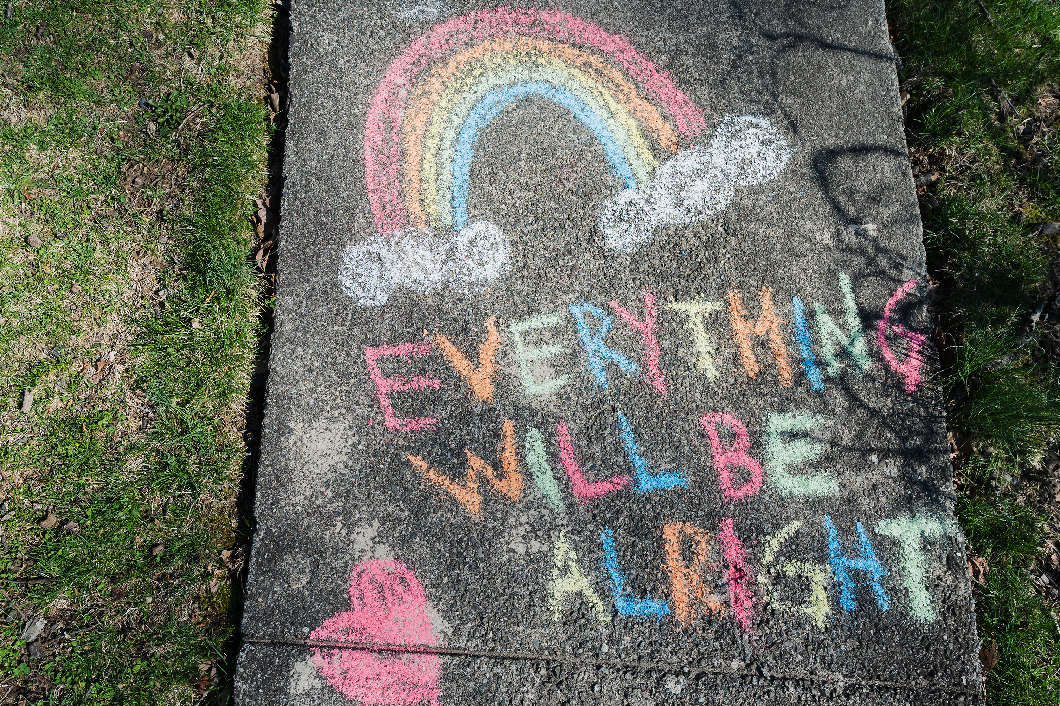
3. Positivity
Notes:
Building positive attitudes and skills, promoting healthy norms about relationships, including sexual relationships where relevant. Avoid language which normalises harmful behaviour. Sex should be positive and enjoyable.

Slide 11

4. Careful sequencing

Slide 12
Curriculum
In line with pupil needs
Break down skills and knowledge into manageable and well-sequenced units
All pupils are challenged
Cross-curricular – complement, reinforce, and avoid duplication

Slide 13

5. Relevant and responsive

Slide 14

6. Skilled delivery of participative education

Slide 15
Delivery
Opportunities to practise skills.
Use distancing techniques and ground rules, agree confidentiality.
Schools always responsible for the content that is taught even when using external providers.
Be cautious of organisations that promote harmful products (eg. alcohol or tobacco) or have strong partisan views.
School’s responsibility to ensure resources and teaching materials are age appropriate.
All teachers and visitors know how to respond to safeguarding concerns.

Slide 16

7. Whole school approach

Slide 17
Governors and Trustees
All pupils make progress
Teaching is accessible to all pupils with SEND
Curriculum content and teaching materials are aligned with statutory guidance
Clear information is provided for parents on the subject content, teaching materials and external providers and right to withdraw.

Slide 18

RSE policy
Proactively engage and consult with parents developing and reviewing policy
Provide free to anyone who wants it
Publish on your website
Where new content is needed – inform parents of any shifts away from the policy and continue to share materials on request.

Slide 19
RSE Policy
Subject content – how and when it will be taught
Who is responsible for teaching (include any external providers)
Differentiate between relationships and sex education
Parent’s right to request withdrawal from sex education
Accessibility for SEND and others
Monitoring and evaluation
How parents can view materials
How teachers will answer questions on sex education
How policy has been produced and approved
When the policy will be reviewed

Slide 20
Theme areas - Primary
Relationships education
Families and people who care for me
Caring friendships
Respectful, kind relationships
Online safety and awareness
Being safe
Health and Wellbeing
General wellbeing
Wellbeing online
Physical health and fitness
Healthy eating
Drugs, alcohol, tobacco and vaping
Health protection and prevention
Personal safety
Basic first aid
Developing bodies
67 to 80 outcomes

Slide 21
Theme areas - Secondary
Relationships education
Families
Respectul relationships
Online safety and awareness
Being safe
Intimate and sexual relationships including sexual health
Health and Wellbeing
Mental wellbeing
Wellbeing online
Physical health and fitness
Healthy eating
Drugs, alcohol, tobacco and vaping
Health protection and prevention and understanding the healthcare system
Personal safety
Basic first aid
Developing bodies
65 to 115 outcomes

Slide 22
Health and wellbeing
Enabling pupils to make good decisions about their own health and wellbeing
Recognise when things are not right
Support pupils to develop strategies for self-regulation, perseverance and determination
Reduce stigma
Discourage pejorative use of language
Promote openness
Complement teaching about menstruation with sensitive arrangements for managing periods

Slide 23
Sex education
Remains non-statutory at primary.
Recommend in year 5 and/or year 6.
Schools may cover human reproduction in Science, in line with the factual description of conception in the Science curriculum.
Consult with parents about what will be taught.
Offer support to parents to talk to their children about sex education.
Names for body parts is part of health education ‘developing bodies’.
Topics related to preventing sexual abuse or avoiding sharing inappropriate material online can be done without describing the detail of any sexual activity involved and are therefore relationships education.

Slide 24
Start early!
“The focus for primary relationships education should be on teaching the skills and knowledge that form the building blocks of all positive relationships, supporting children from the start of their education to grow into kind, caring, adults who have respect for others and know how to keep themselves and others safe.”

Slide 25
Content additions - primary
Balancing needs and wants of different people in relationships
Setting and respecting boundaries
Communication: assertiveness; managing conflict; expressing needs and boundaries
Change, loss and bereavement
Difference between assertive and controlling behaviour
Online risks: age ratings; information sharing; harmful and upsetting content; gaming monetisation; scams; fraud
Recognising when relationships are harmful or dangerous
Qualities of online relationships
Importance of a healthy relationship with food

Slide 26
Content additions - primary
Hazards and keeping safe: fire; road; water safety code
Vaping, nicotine addiction and nicotine pouches
Reporting incidents to emergency services not filming them
Names for body parts: penis, testicles, vulva, vagina, nipples
Align teaching of vaccinations to the time they are taking place
Avoiding pressure
Challenging stereotypes
Addition of civil partnerships when talking about marriage

Slide 27
Flexibility to safeguard at primary
Protective and preventative content.
Not causing unreasonable alarm or normalising risky behaviours or activities.
Can cover issues affecting pupils in school, eg. sharing of naked images or accessing pornography.
Teaching should be age appropriate and respectful.
Recognise that some children will have no familiarity with the topics.
Inform parents of any deviation from RSE policy in advance and share any relevant materials with them on request.

Slide 28
Content additions - secondary
Common law marriage is a myth
How families change over time
Importance of self-esteem
Skills for ending relationships
More around consent
Inequalities of power
Sub-cultures and involuntary celibates
Online risks: Social media, AI, chatbots, deepfakes, scams, sextortion, bullying, sale or purchasing of drugs/knives, harmful content
Personal safety
Fixated, obsessive behaviours
Sexual harassment
FGM
Strangulation and other harmful sexual acts
Role of pornography
Sex should be enjoyable
PrEP and PEP
Seeking support around sexual violence and harm

Slide 29
Content additions - secondary
Mental health – gambling, overcoming anxiety, co-occurrence with drugs/alcohol
Prevalence and characteristics of more serious health conditions
Risks of weight gain
Vaping – risks but also role in quitting smoking, also illicit vapes
Risks of drink spiking and poisoning from methanol
Navigating healthcare system; Role of pharmacists; A&E
Healthy behaviours before and during pregnancy: folic acid, pelvic floor
Pregnancy loss and miscarriage
Gillick competence
Social and emotional skills to manage conflict and avoid violence
Laws around knives and violence
Menstrual and gynaecological health – period problems, premenstrual syndrome, endometriosis, polycystic ovary syndrome
Reproductive health, including fertility and menopause

Slide 30
The law
Starting principle should be the law. Teach factually so children know their rights.
Marriage, forced marriage, civil partnerships
Consent, age of consent
Domestic abuse, stalking, rape, sexual offences, FGM, ‘virginity testing’ and hymenoplasty
Sexual abuse, harassment and exploitation, including public sexual harassment nd harmful sexual behaviour
The online safety act
Online behaviours including sexual imagery, nudes, AI-generated.
Pornography
Abortion
Protected characteristics
Alcohol, smoking, vaping and nicotine produces and illegal drug use
Gambling
Carrying knives and weapons
Extremism/radicalisation
Grooming or criminal exploitations, county lines, gang involvement
Hate crime
The age of criminal responsibility
Medial consent, Gillick competence, parental responsibility

Slide 31
Health and wellbeing
Secondaries can choose to teach about issues not included, such as eating disorders and self-harm – in a safe way, with qualified support and advice, ensure teachers are properly equipped.
Secondary schools should also consider how to safely address suicide prevention – consult with mental health professionals, and put in place high quality training, mindful of language and content
No instructions of methods of self-harm, eating disorders or suicide and avoid using emotive language, videos or images

Slide 32
Equality
Schools must comply with the Equality Act and Public Sector Equality Duty
Must ensure topics are taught in a way that does not discriminate against pupils or amount to harassment
Pupils should learn about equality and the protected characteristics.

Slide 33

Inclusion - LGBT
Primary schools strongly encouraged to include same-sex parents when discussing families.
At secondary, there should be an equal opportunity to explore healthy same-sex relationships.
LGBT content should be integrated not standalone at secondary.
Ensure that sexual health is relevant to those who are lesbian, gay, bisexual and/or gender questioning.

Slide 34
Inclusion – Gender reassignment
Pupils should be taught:
The facts and the law about biological sex and gender reassignment, recognising the legal rights by virtue of biological sex which are different from the rights of the opposite sex with the protected characteristic of gender reassignment.
People with the protected characteristic of gender reassignment are protected from discrimination and should be treated with respect and dignity.

Slide 35
Inclusion – Gender reassignment
Avoid the debate, do not endorse any particular view or teach it as fact.
Do not teach as fact that people have a gender identity.
Avoid language and activities that repeat or enforce gender stereotypes.
Do not suggest that social transition is a simple solution to feelings of distress or discomfort.
Encourage pupils to consider how to express their views while remaining respectful of the opinions of others.
Be clear that bullying or disrespectful language or behaviour is never appropriate.
Do not use resources that oversimplify the topic, such as cartoons.
Schools should consult parents on the content of external resources on this topic in advance and make all materials available to them on request.

Slide 36
Inclusion
Sensitive to the religious background of pupils
All schools may teach about faith perspectives.
Faith schools can teach their distinctive faith perspective on relationships, and balanced debate may take place about issues that are contentious.
Schools must be clear when they are delivering content that reflects religious belief
Teaching should be accessible for pupils with SEND, who may be more vulnerable

Slide 37
Addressing sexual harassment and sexual violence
Part of a whole school approach.
Develop pupils’ understanding.
Consistently challenge.
Build a culture.
Model behaviour and language.
Develop positive conceptions of masculinity and femininity, including positive role models.
Encourage critical analysis of sexist and misogynistic influencers.
Encourage ethical behaviour beyond respecting boundaries and consent.
Opportunities to practise respectful communication and understand different experiences.
Sex separation can occur if needed to create a safe space for discussion.

Slide 38
Safeguarding
All staff should know what to do if they have concerns, following the process set out in KCSIE.
Do not promise confidentiality
Pupils should understand how they report concerns and ask for help.
Signpost to internal and external sources of support.
Staff should be aware of mandatory reporting duties, including FGM.
Agree with external visitors what to do with safeguarding concerns.
Where there are concerns about a risk of pupils experiencing or perpetrating harms, staff should follow their child protection policy and speak with the DSL.
Claire.maclean@nottinghamcity.gov.uk

Slide 39

Why are you teaching RSHE in your school?

Slide 40
What will you do next?
Example actions:
Policy review
Curriculum review (content, time, style)
Gather pupil voice
Carry out parent consultation
Consult other stakeholders
Parent briefings on new guidance
Review processes for parent communication
Staff training needs assessment
Staff briefings/training
Engage with support from Achieve Well Team and other organisations
Guiding principles:
Engagement with pupils
Engagement and transparency with parents
Positivity
Careful sequencing
Relevant and responsive
Skilled delivery of participative education
Whole school approach

Slide 41
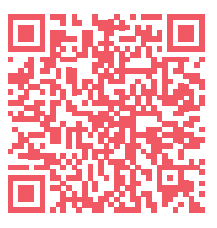
Achieve Well Team offer
Engagement with pupils: Health and Wellbeing survey PSHE Ambassadors
Positivity, careful sequencing, relevant and responsive: Resources Consultancy Training and Networks On demand training
Skilled delivery of participative education: Training and Networks On demand training Conference
Whole school approach: Health and Wellbeing Awards
Mailing list
Partners

Slide 42

What are we planning?
Tools to help you implement the new guidance – policy template, parent resources, etc.
Co-produced resources with our pupil PSHE ambassadors
Launch of Achieve Well Challenges app
Small grant scheme for healthy eating and nutrition projects – from September
How else can we support you? Complete the form
https://forms.office.com/e/CG27e5bktF

Slide 43
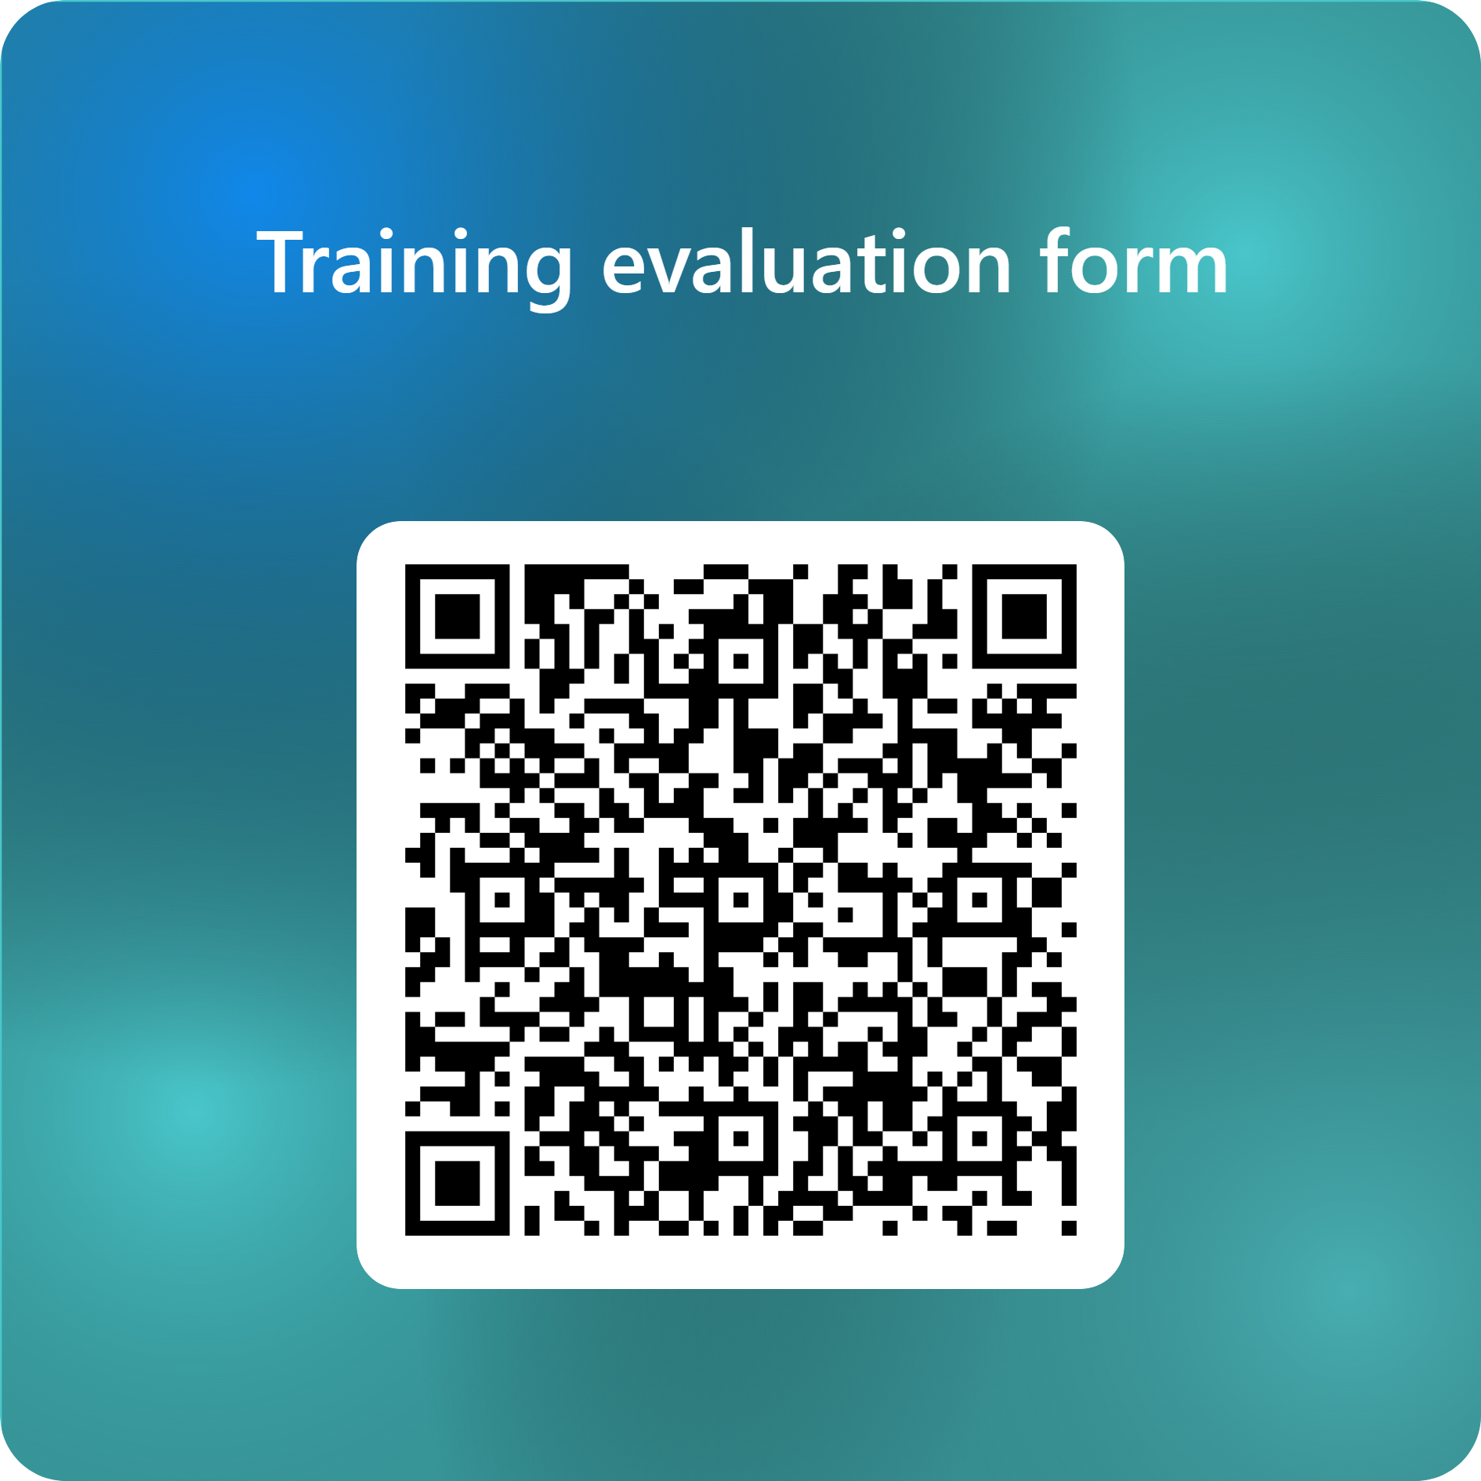
Thank you for joining us. We hope to work with you again soon. https://forms.office.com/e/zAyffdytxh

